Slide 1



ONLINE
SUPER POWERS
Presented by Shared Hope International
Notes:
Suggested Script:
Hi everyone, we are so excited to be here today with all of you! Our job is to help kids stay safe and make smart choices online. Today, you’re going to learn how to use your Online Super Powers to protect yourself, have fun, and make good choices!

Slide 2




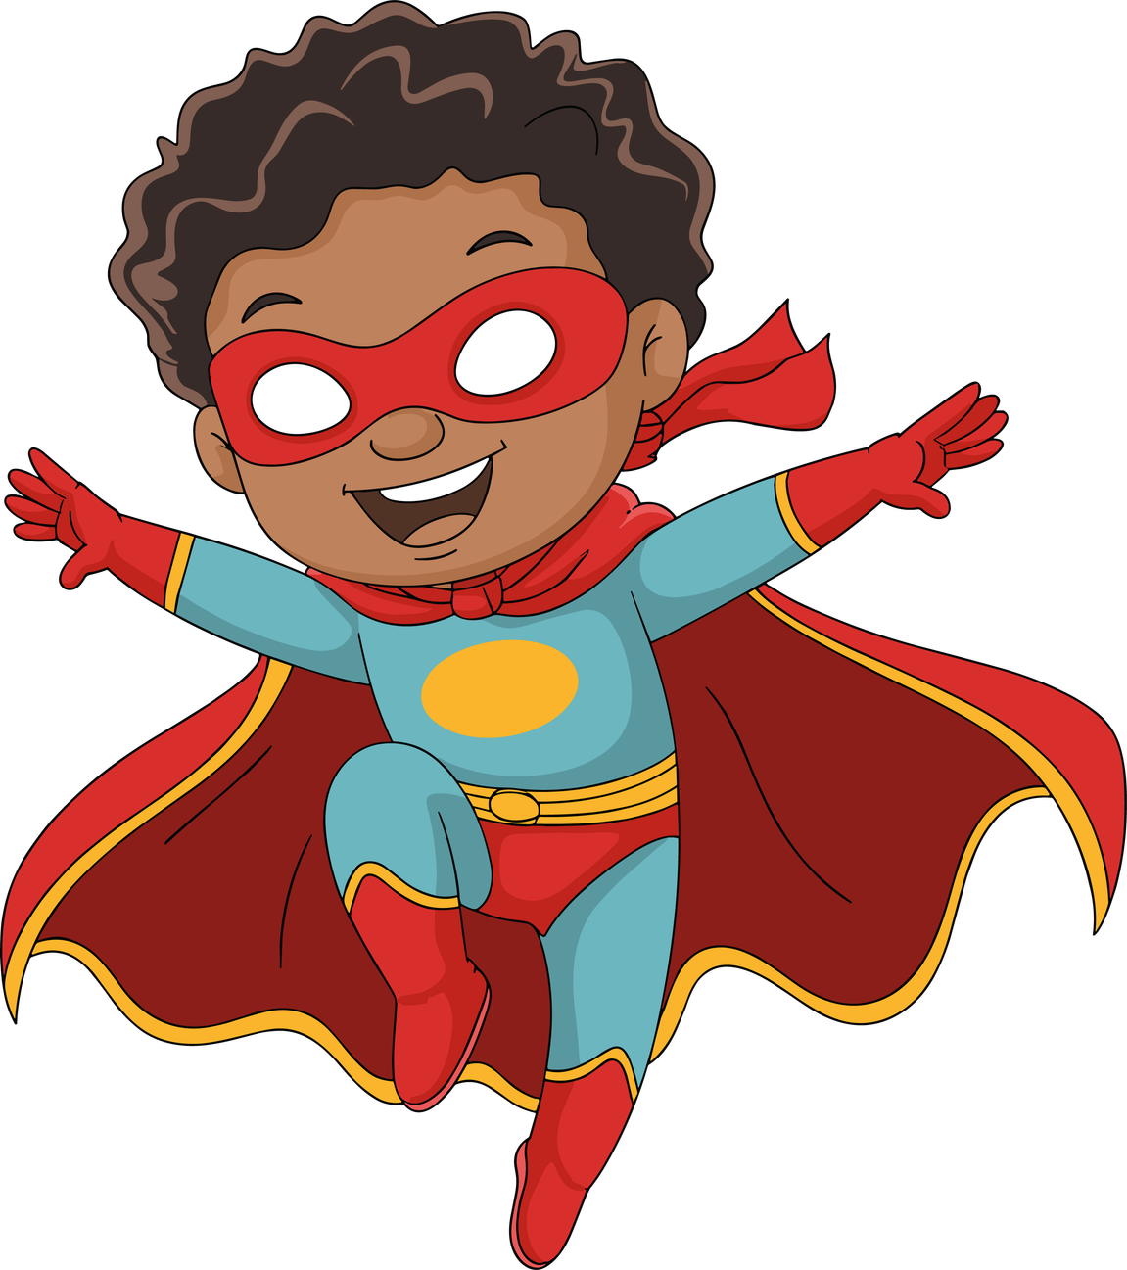
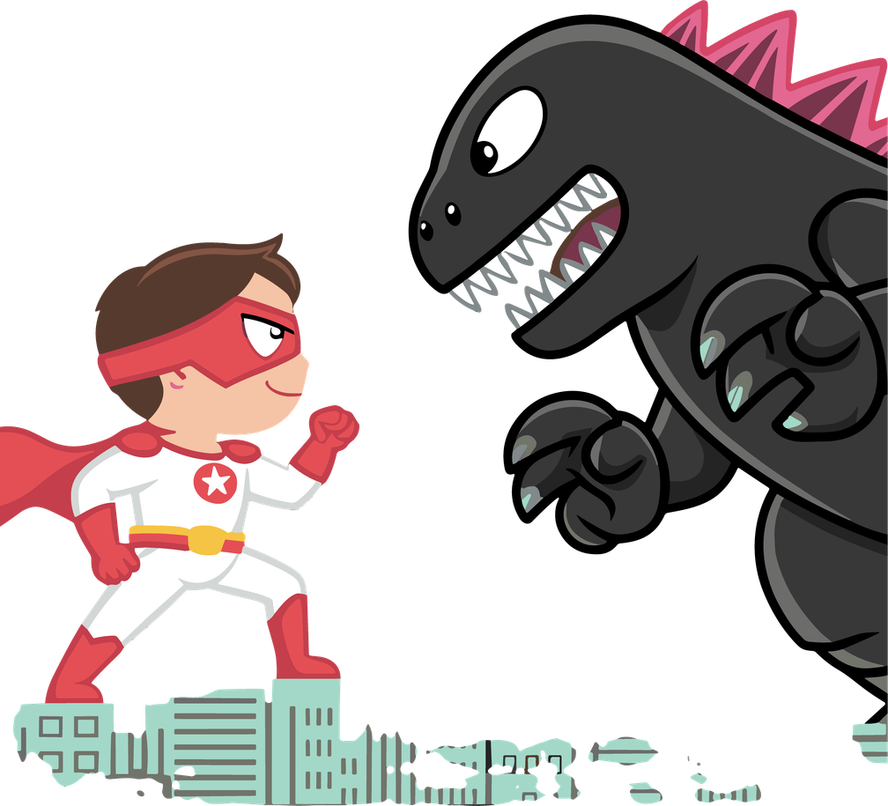
What is The Internet?
Just like in real life, some people online are kind and safe — and some are not.
A PLACE WHERE WE:
Play games
Watch videos
Chat with friends
Learn new things
That’s why we need to be SMART and CAREFUL!
Notes:
Suggested Script:
The internet is like a huge world filled with games, videos, conversations, and apps. It’s fun and you can do so many cool things, but just like in the real world, we need to know how to stay safe and use our superpowers to protect ourselves.

Slide 3

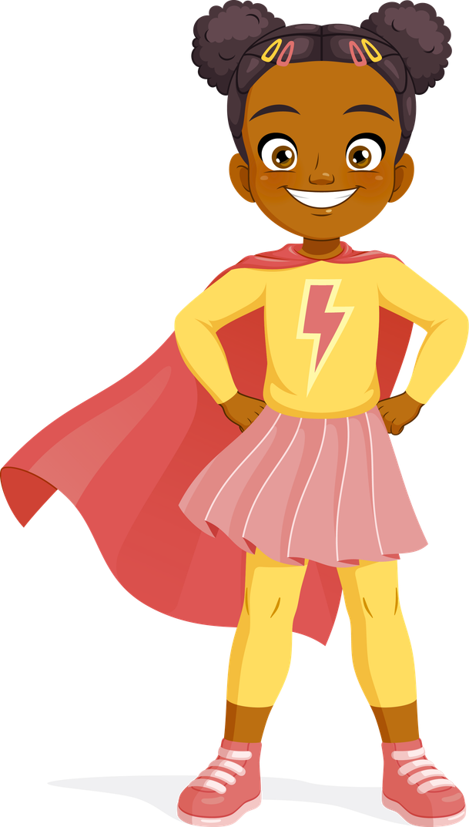
SuperHeroEs Dont give out their Powers!!
Your name, pictures, address, and school are all special - Don’t give them out!
Use fun nicknames instead that don’t giveaway too much of your powers.
Talk to a safe adult before sharing pictures or videos online!
Notes:
Suggested Script:
Every superhero has special powers, and YOUR special power is your personal information. Let me ask you this question, what does 'personal information' mean? (let a few kids answer)
That's right! It means your real name, your school, where you live, and pictures of your and your family.
You don’t just hand your superpowers to anyone right?
Exactly, so you need to protect them. And if you want to post or share something, you talk to a trusted adult first.

Slide 4



YOUR SUPER HERO BASE
Only talk online with people you know in real life — like superheroes only let trusted friends in their base!
If someone tries to contact you, alert your “guard” (parents, teacher, or trusted adult).
Notes:
Suggested Script:
Superheroes keep their team small and safe.
Ask the kids: Who are some of your favorite heroes and who are their close friends?
When you are online that means only talking to people you know in real life such as friends, family, and classmates. If you don’t know them offline, they don’t belong in your superhero base!

Slide 5





WATCH OUT FOR ONLINE DISGUISES AND TRICKY SITUATIONS
If someone asks you to do something that feels weird or sneaky...
SPEAK UP!
It’s never your fault if someone tries to
trick you.
If someone asks for pictures, or makes you uncomfortable...
Tell a trusted adult!
Notes:
Suggested Script:
People online can pretend to be anyone. Sometimes they use disguises and trick you — like asking you to keep secrets, trying to chat privately, or giving you a weird feeling in your tummy. That’s when your superhero alarm goes off. If that alarm goes of and if ANYTHING feels weird or confusing, you tell a trusted adult right away!

Slide 6


SMart Online Choices = Trusting your super senses!
THINK... before you share.
KEEP... strong passwords.
PAUSE...if someone asks you to meet in person.
Notes:
Suggested Script:
Superheroes think before they act. You have to use your ‘super senses’ online.
THINK, KEEP, and PAUSE.
Think before you share or post personal information, remember to keep your powers safe from bad guys. If something is private or could hurt you later, don’t share it!
Keep strong passwords you create for your games and account online. Have your parents or a safe adult help you make passwords you will remembers and don't share them with anyone else.
Pause if someone you don't know in real life asks you to meet in person. Don't respond to them and tell a safe adult right away.

Slide 7












NAME THAT ICON!!
Notes:
Suggested Script:
Alright heroes, it's time to test your super knowledge!
On the screen you may see icons that you know or use, and some you may not know. Our mission is to use your online super knowledge to guess what each one is!
Why are we doing this? Because real superheroes stay safe online. Knowing what apps these are can help you make smarter choices when you use them or if you see a friend using them.
Are you heroes ready!?
Raise your hand if you know one of these icons....how about two...now three... (keep going if you have time or pick on certain kids to tell you one by one which icon is which. You can also ask them how they know that icon and what it does.)
WhatsApp: (The green app with the phone symbol)
A wifi connected chat app to message others individually or in a group.
TikTok: (The black app with a music note)
A social media app where people make and watch short videos.
Snapchat: (The yellow app with the ghost)
A messaging app where photos and messages disappear after you see them.
Instagram: (The orange, pink, and purple app with the camera)
A social media app for sharing photos, short videos, and stories.
Twitch: (The purple text box)
A website where people livestream themselves playing video games or doing activities.
Roblox: (The grey square)
An online game world where you can play games made by other players.
Fortnite: (The F)
A popular video game where players compete, build, and survive in matches.
Minecraft: (The brown and green square logo)
A block-building game where you create worlds, explore, and survive.
YouTube: (The red app with the white play symbol)
A place to watch and post long and short video content.
Discord: The circle app that is a bluish purple)
A chat app with text, voice, and video used by gamers and groups to talk.

Slide 8


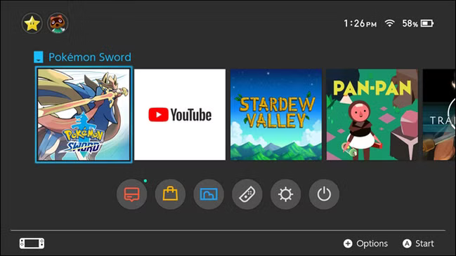





Congratulations Gamer!!
YOU have been chosen to get the MEGA STAR PLAYER PASS
for ALL online games!
You’ll Unlock:
✨ Super speed
✨ Rainbow skins
✨ Unlimited coins
✨ Secret levels
To activate your pass, type in:
Your full name
Your email address (to get your prizes)
A selfie to post on our WINNER board!
Hurry there’s only 5 minutes left to claim!!
Mega‑Player‑Pass.superbonus‑gate
Notes:
Suggested Script: Now, use your superpower knowledge and senses to pick out what seems sneaky or dangerous about this ad.
Why is this ad dangerous?
-Asks for private info. This is always unsafe
-Fake “chosen winner”
-Pressure countdown, this tries to make kids act fast in 5-minutes or less.
-Strange web address... this is suspicious
-Free stuff that sounds too good to be true
- Discussion with the students:
What clues show this isn’t safe?
Do you think it's okay they asked for a picture of you and your address?
Explain..... What should you do if you see something like this online?

Slide 9




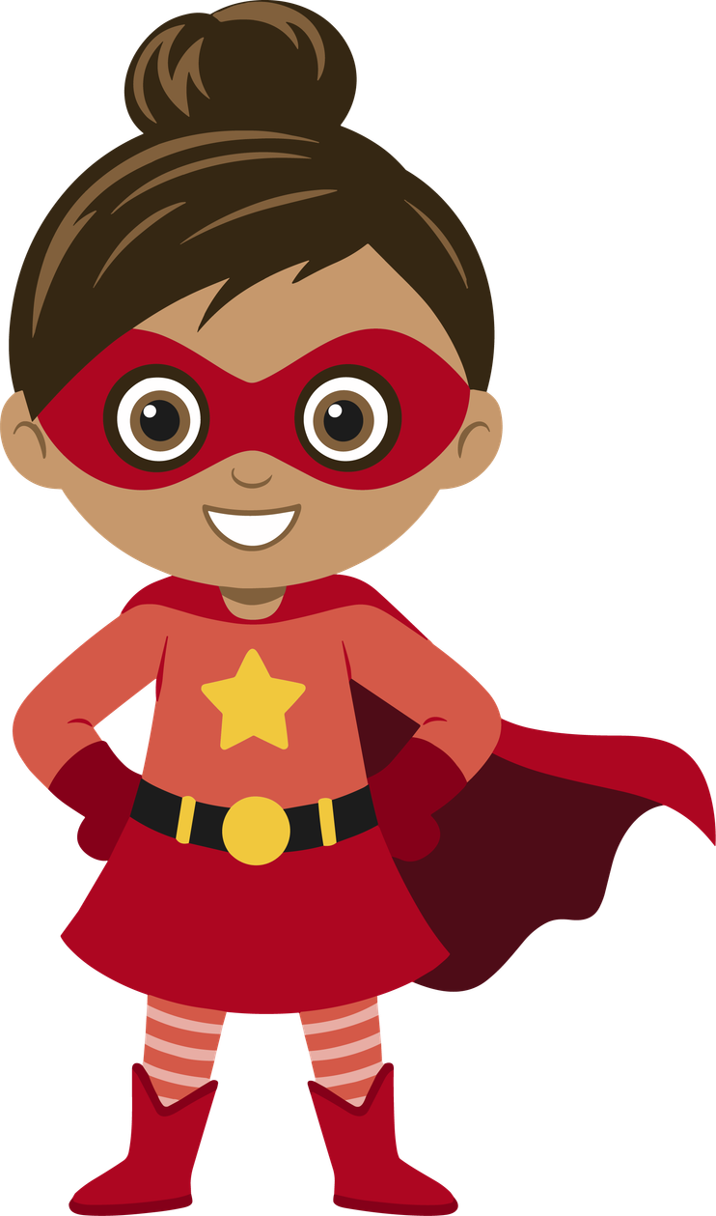




Do you want to Become a Kid influencer?
Show everyone how famous you are!
To join, you must...
Send us your name and age
Send us a picture or a video of what you look like
Tell us what school you go to
Promise not to show this message to adults
You could get
Shoutouts
influencer gifts
Free merch
“VIP Creator” status
Notes:
Suggested script:
Now let’s look at an example of a tricky message kids might see online.
Ask the students:
What made this flyer seem exciting?
-Become famous online
-Be more popular than you were before
-Free gifts, merch, and upgraded status on the platform
What are the red flags or what doesn't feel right?
-Promises are too good to be true
-Asking to share private information
-Hiding this offer from adults and parents
This flyer promises gifts, prizes, and becoming famous, but it asks you to share photos, personal info, and to keep secrets from adults. These are BIG red flags. Superheroes don’t fall for tricks like this because they protect their identity and tell a trusted adult.
Why do unsafe people sometimes offer prizes, gifts, or higher online status?

Slide 10
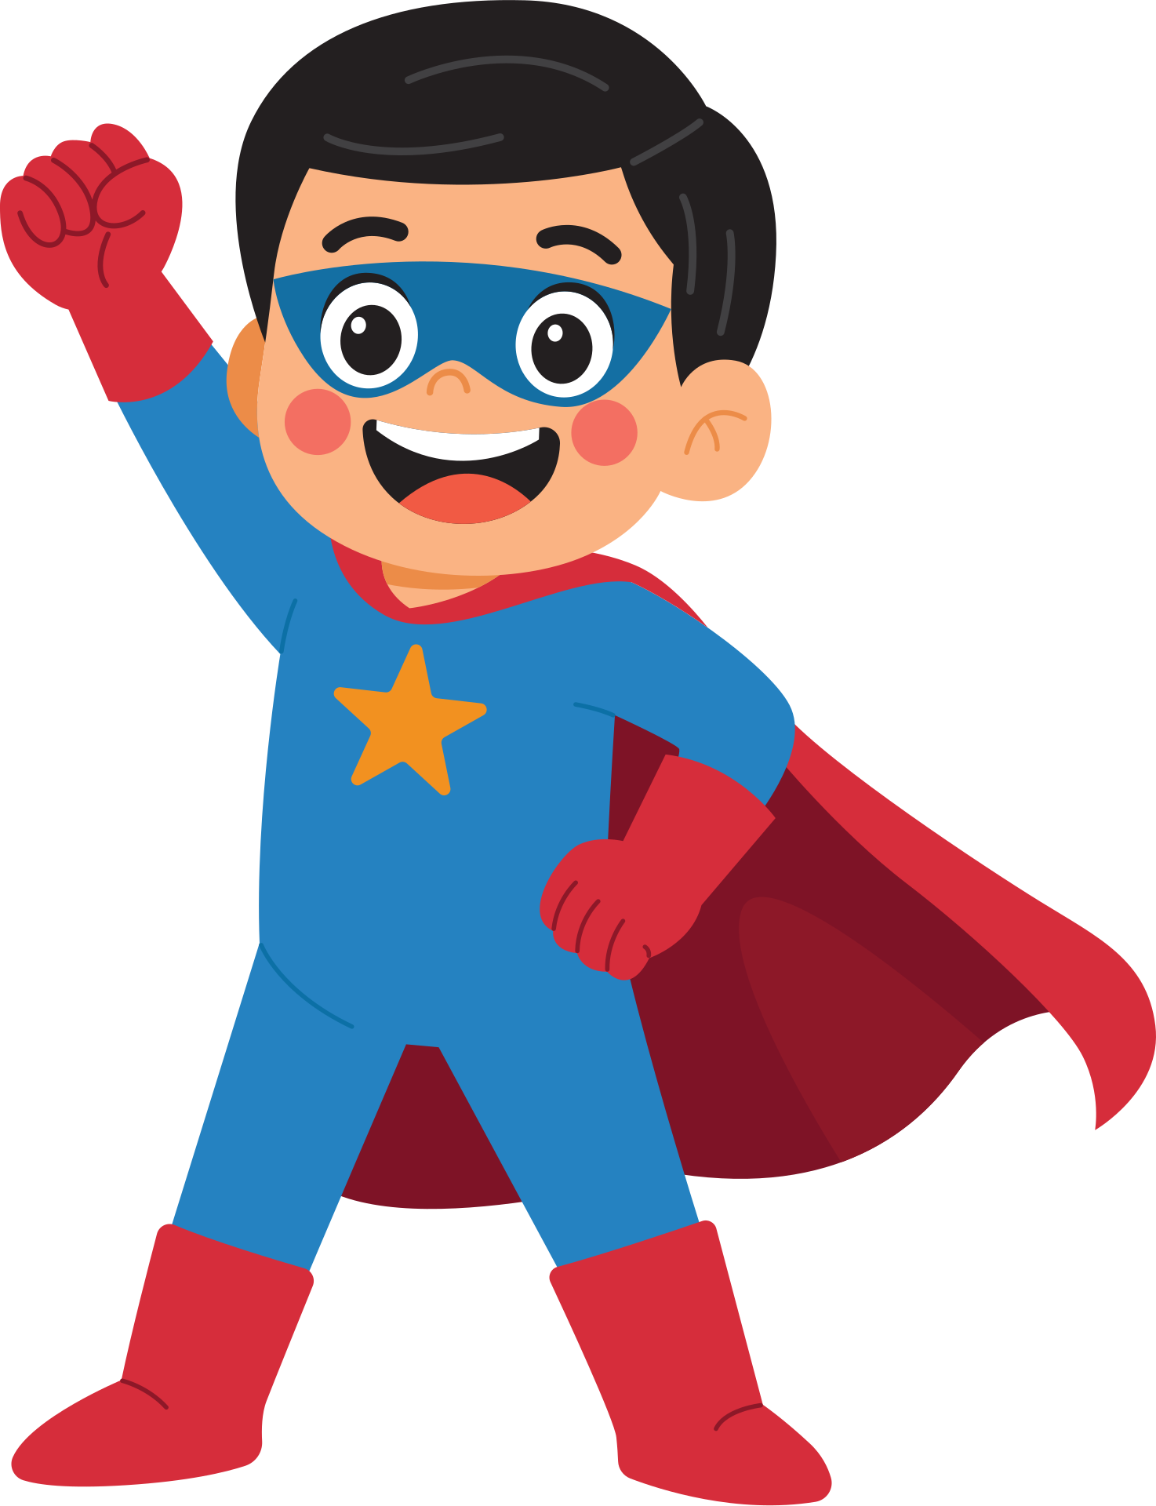

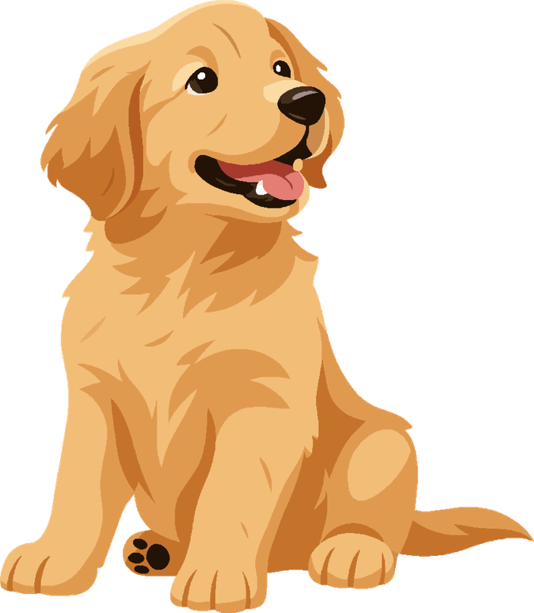

FREE PUPPIES!!
first come first serve
Have you always wanted a puppy?
your parents won’t be able to say no!
this saturday only
Must be 8 years or older
send us a picture of yourself and tell us why you want a puppy: @kidsluvpups112
We will Dm you and let you know where to meet up!
Notes:
Suggested script:
Now let’s look at an example of a tricky message kids might see.
Ask the students:
What made this flyer seem exciting?
-Free puppies
-Easy to get a puppy, just post a photo and you can win.
-You don't have to be that old to get a puppy (8+)
What are the red flags or what doesn't feel right?
-You have to send a selfie to an unknown account online.
-You're doing this behind your parents back without asking.
-They will DM (direct message) without your parents knowing.
-They mention meeting up to get the puppy.
This flyer promises a new puppy but it asks you to share photos and asking you to meet up with them in real life. These are BIG red flags. Superheroes don’t fall for tricks like this because they protect their identity and tell a trusted adult.
Why do unsafe people sometimes offer cute puppies and tell you, you have to meet them in order to get your new puppy!?

Slide 11



Never
NEVER share personal info.
NEVER talk privately with strangers.
NEVER keep online secrets from adults.
NEVER send pictures or videos without permission.
Notes:
Now we're going to talk about some important online safety rules. These are simple Always and Never rules that help keep you safe when you’re using apps, games, or talking online.
These rules are not to scare you, they’re rules to help you make smart choices. If you remember these, you’ll know what to do when something doesn’t feel right online.
Let’s go through them together starting with the NEVER rules.
When I point to the word "NEVER" you all say it loud and I will read the rest of the rule.
Here we go...
(Kids will yell or say "NEVER" and then you say the rest of the sentence. This gets them involved in the presentation and helps them to remember what to say NEVER to.)

Slide 12

always
ALWAYS keep your info private.
ALWAYS choose friends you know in real life.
ALWAYS tell a trusted adult if something feels off.
ALWAYS block and report anyone who makes you uncomfortable.
Notes:
Now we're going to talk about some important online safety rules. These are simple Always rules that help keep you safe when you’re using apps, games, or talking online.
When I point to the word "ALWAYS" you all say it loud and I will read the rest of the rule.
Here we go...
(Kids will yell or say "ALWAYS" and then you say the rest of the sentence. This gets them involved in the presentation and helps them to remember what to say ALWAYS to.)

Slide 13


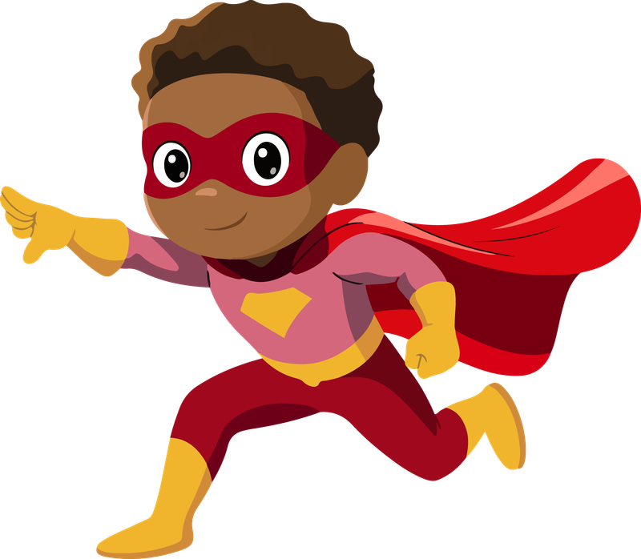
Be a NOSY friend!!
What does being a nosy friend mean?
A NOSY friend pays attention when something looks wrong online.
They ask their friends questions about strange messages or posts.
They tell a trusted adult if something feels or seems unsafe.
Gently ask your friend, “Are you okay?” or “What happened?”
Being nosy (the good kind!) means you care and want to help keep friends safe!
Notes:
Explain that being a NOSY friend is a good thing, not bad. It means looking out for your friends.
Here are some examples they could relate to:
- If a friend gets a message from someone they don’t know, a NOSY friend asks, ‘Who is that?’ instead of ignoring it.
- If you see a post that looks strange or makes your friend scared, tell a trusted adult like a parent, teacher, or counselor.
Being NOSY is like being a superhero for your friends, you’re helping them stay safe!

Slide 14
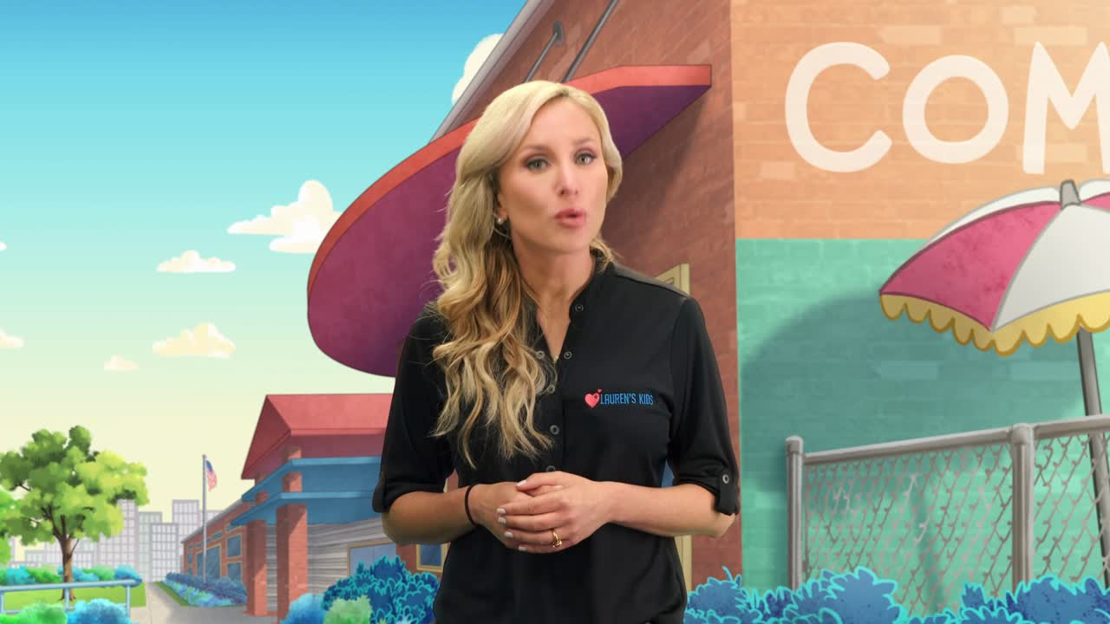
laurenskids.org
Notes:
Suggested Script:
This is a video by Lauren Book at Lauren's Kids. You will need internet connection to play this video off of YouTube. If the video does not play, please share the link with the teacher or group leader to share with students later.
https://www.youtube.com/watch?v=bIN3e45kMgU

Slide 15
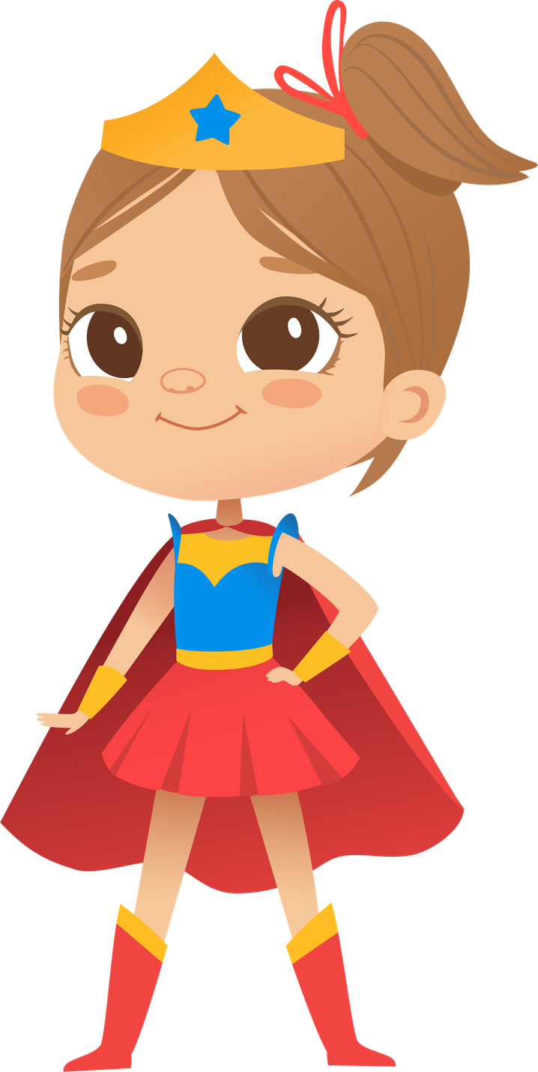

Let’s Stay safe Together!
Each of you has the power to be your own online superhero.
By being smart and careful, you can protect yourself and others.
Remember real heroes don’t wear capes; they make safe choices!
Notes:
Suggested Script:
Today you learned how to be an Online Superhero.
You have learned how to protect your powers, trust your super senses, and make smart choices. When you use these rules, you keep yourself and your friends safe online every day!

